Slide 1

Core JAVA
TRAINING & RECRUITMENT
OFFSHORE DEVELOPMENT
IDENTITY MANAGEMENT
PORTAL DEVELOPMENT
APPLICATION DEVELOPMENT

Slide 2
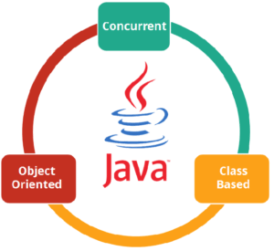
What is Java?
Java is a cross-platform object-oriented programming language that was released by James Gosling with other team members also called as Green Team in 1995 for Sun Microsystems.
Java is considered both a compiled and interpreted language. It is because Java source code is first compiled to bytecode which is then interpreted by Java Virtual Machine. Java Virtual Machine interprets the bytecode and converts it to platform specific machine code. Hence, Java is also called a platform-independent programming language.
It is an object-oriented language which is free to access and can run on all
platforms.
Concurrent where you can execute many statements instead of
sequentially executing it.
Class-based and an object-oriented programming language.
Independent programming language that follows the logic of
“Write once, Run anywhere”
i.e. the compiled code can run on all platforms which supports java.

Slide 3
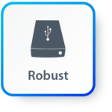

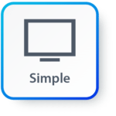
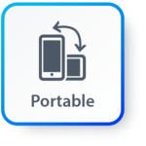

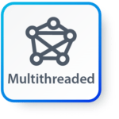
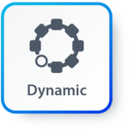
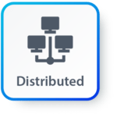
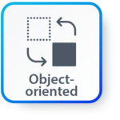
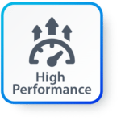
Features
Simple: Java has made life easier by removing all the complexities such as pointers, operator overloading as you see in C++ or any other programming language.
Portable: Platform independent.
Object-oriented: Everything is considered to be an “object” which possess some state, behavior and all the operations are performed using these objects.
Secured: All the code is converted in bytecode after compilation, which is not readable by a human. and java does not use an explicit pointer and run the programs inside the sandbox to prevent any activities from untrusted sources. It enables to develop virus-free, tamper-free systems/applications.
Dynamic: It has the ability to adapt to an evolving environment which supports dynamic memory allocation due to which memory wastage is reduced and performance of the application is increased.
Distributed: This language provides a feature which helps to create distributed applications. Using Remote Method Invocation (RMI), a program can invoke a method of another program across a network and get the output. You can access files by calling the methods from any machine on the internet.
Robust: Java has a strong memory management system. It helps in eliminating error as it checks the code during compile and runtime.
Multithreaded: Java supports multiple threads of execution (a.k.a., lightweight processes), including a set of synchronization primitives. This makes programming with threads much easier.
Interpreted: Java is compiled to bytecodes, which are interpreted by a run-time environment.
High Performance: After the bytecode is compiled by the Java compiler, it is provided to JVM, before it is converted to machine-level code. This helps in a great performance for the Java language.

Slide 4

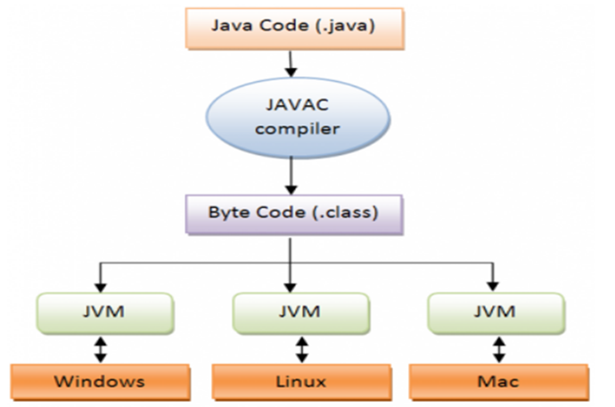
There are three main components of Java language: JVM, JRE, and JDK.
Java Runtime Environment(JRE) : The Java Runtime Environment (JRE) contains all of the libraries and software required to run Java programs. JRE is a disk-based system that mixes Java code with necessary libraries.
Java Development Kit(JDK): It’s a Java application and applet development environment.
Java(loader/executor): responsible for launching Java applications
javac(compiler): It is responsible for compilation of java programs
Javadoc: provides support for generation of API documentation
Jar: responsible for creating and managing all JAR files.
Java Virtual Machine(JVM) : The basic job of the JVM is to transform byte code into machine code. On the whole, JVM performs these functions – loads and verifies the code and then executes the code, and enables the runtime environment.

Slide 5
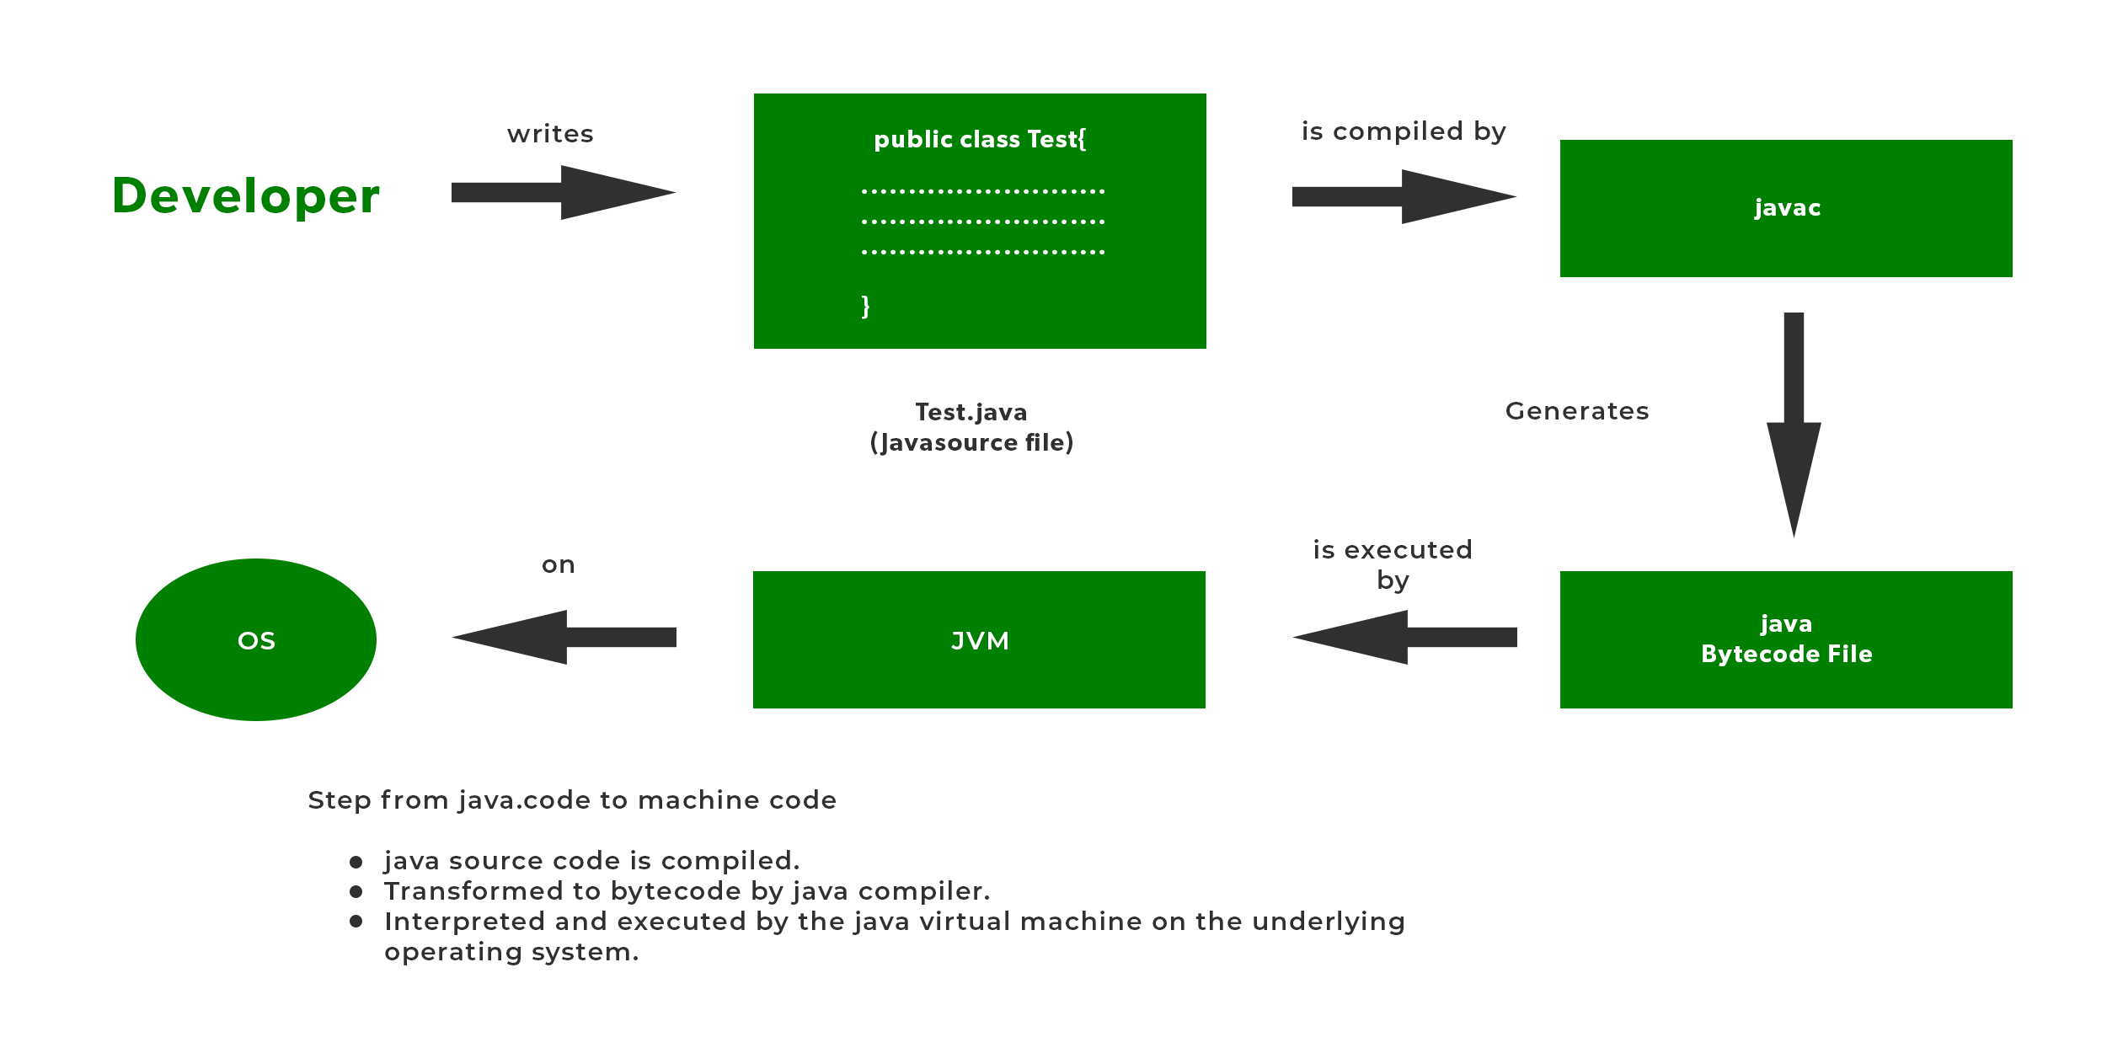
Java Compiler and Interpreter

Slide 6
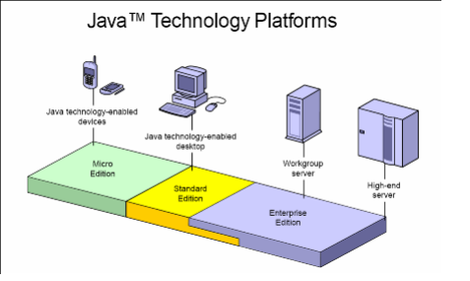
Java Platform Editions
Java Standard Edition( Java SE ) : allows Java developers to develop
standalone console-based, applets, and desktop applications.
Java SE Platform includes the core APIs and tools to develop Java applications.
Java Enterprise Edition( Java EE ) : allows software teams to develop, deploy and run Java server-side web applications, web services, and multi-tier enterprise applications. An enterprise application should be highly secure, reliable, available, and scalable to the demand. Java EE platform is built on top of Java SE. The major technologies of Java EE include Java Servlets, JSP( Java Server Pages), EJB ( Enterprise Java Beans), JSF, JMS( Java Messaging Service), Support for SOAP/Rest Web Services, etc.
Java Micro Edition( Java ME ): allows Java developers to develop embedded applications for portable small-screen micro devices like pagers, setup boxes, cellphones, mobile applications, etc. Java ME SDK( Software Development Kit ) requires Java SE.

Slide 7
Java Program
Create the source code with .java ext. – example.java
Open command prompt and go to the directory where java file is saved.
On command prompt– javac example.java invokes the java compiler . after compiling the program generates the class file example.class
Execute it(interpretation)- java example
Note: file name should be same as class name.

Slide 8
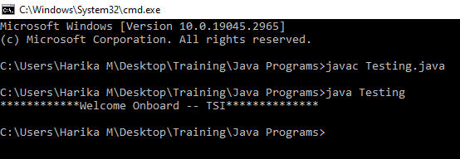
Example :
public class Testing {
public static void main(String[] args) {
System.out.println("************Welcome Onboard -- TSI**************");
}
}

